Slide 1
Network Security
National Taiwan University
of Science and Technology

Slide 2
資料探勘
DATA MINING
Ack. Revised from Jiawei Han and Micheline Kamber’s slides

Slide 3
Outline
What Is Data Mining?
Alternative Names
Potential Applications
Multi-Dimensional View of Data Mining
Process
Data Mining Can Use On What Kinds of Data
Kinds of Functionalities
Classification
Patterns Interesting
Other algorithm

Slide 4
What Is Data Mining?
Data mining (knowledge discovery from data)
  Extraction of interesting (non-trivial, implicit, previously unknown and potentially useful) patterns or knowledge from huge amount
  of data

Slide 5
Alternative Names
Knowledge discovery (mining) in databases (KDD), knowledge extraction, data/pattern analysis, data archeology, data dredging, information harvesting, business intelligence, etc.
Notes:
Dredging: dig mud
Archeology:考古學

Slide 6
Potential Applications
Market analysis and management
  customer relationship management (CRM)
  Risk analysis and management
  quality control, competitive analysis
  Fraud detection and detection of unusual patterns(outliers)
  Network security(Instruction Prevention)
  etc.

Slide 7
Multi-Dimensional View of Data Mining
Data to be mined
  Relational, data warehouse, transactional, stream, object -oriented/relational, active, spatial, time-series, text, multi-media, heterogeneous, legacy, WWW
Knowledge to be mined
  Characterization, discrimination, association, classification, clustering, trend/deviation, outlier analysis, etc.
  Multiple/integrated functions and mining at multiple levels
Techniques utilized
  Database-oriented, data warehouse (OLAP), machine learning, statistics, visualization, etc.
Applications adapted
  Retail, telecommunication, banking, fraud analysis, bio-data mining, stock market analysis, text mining, Web mining, etc.

Slide 8
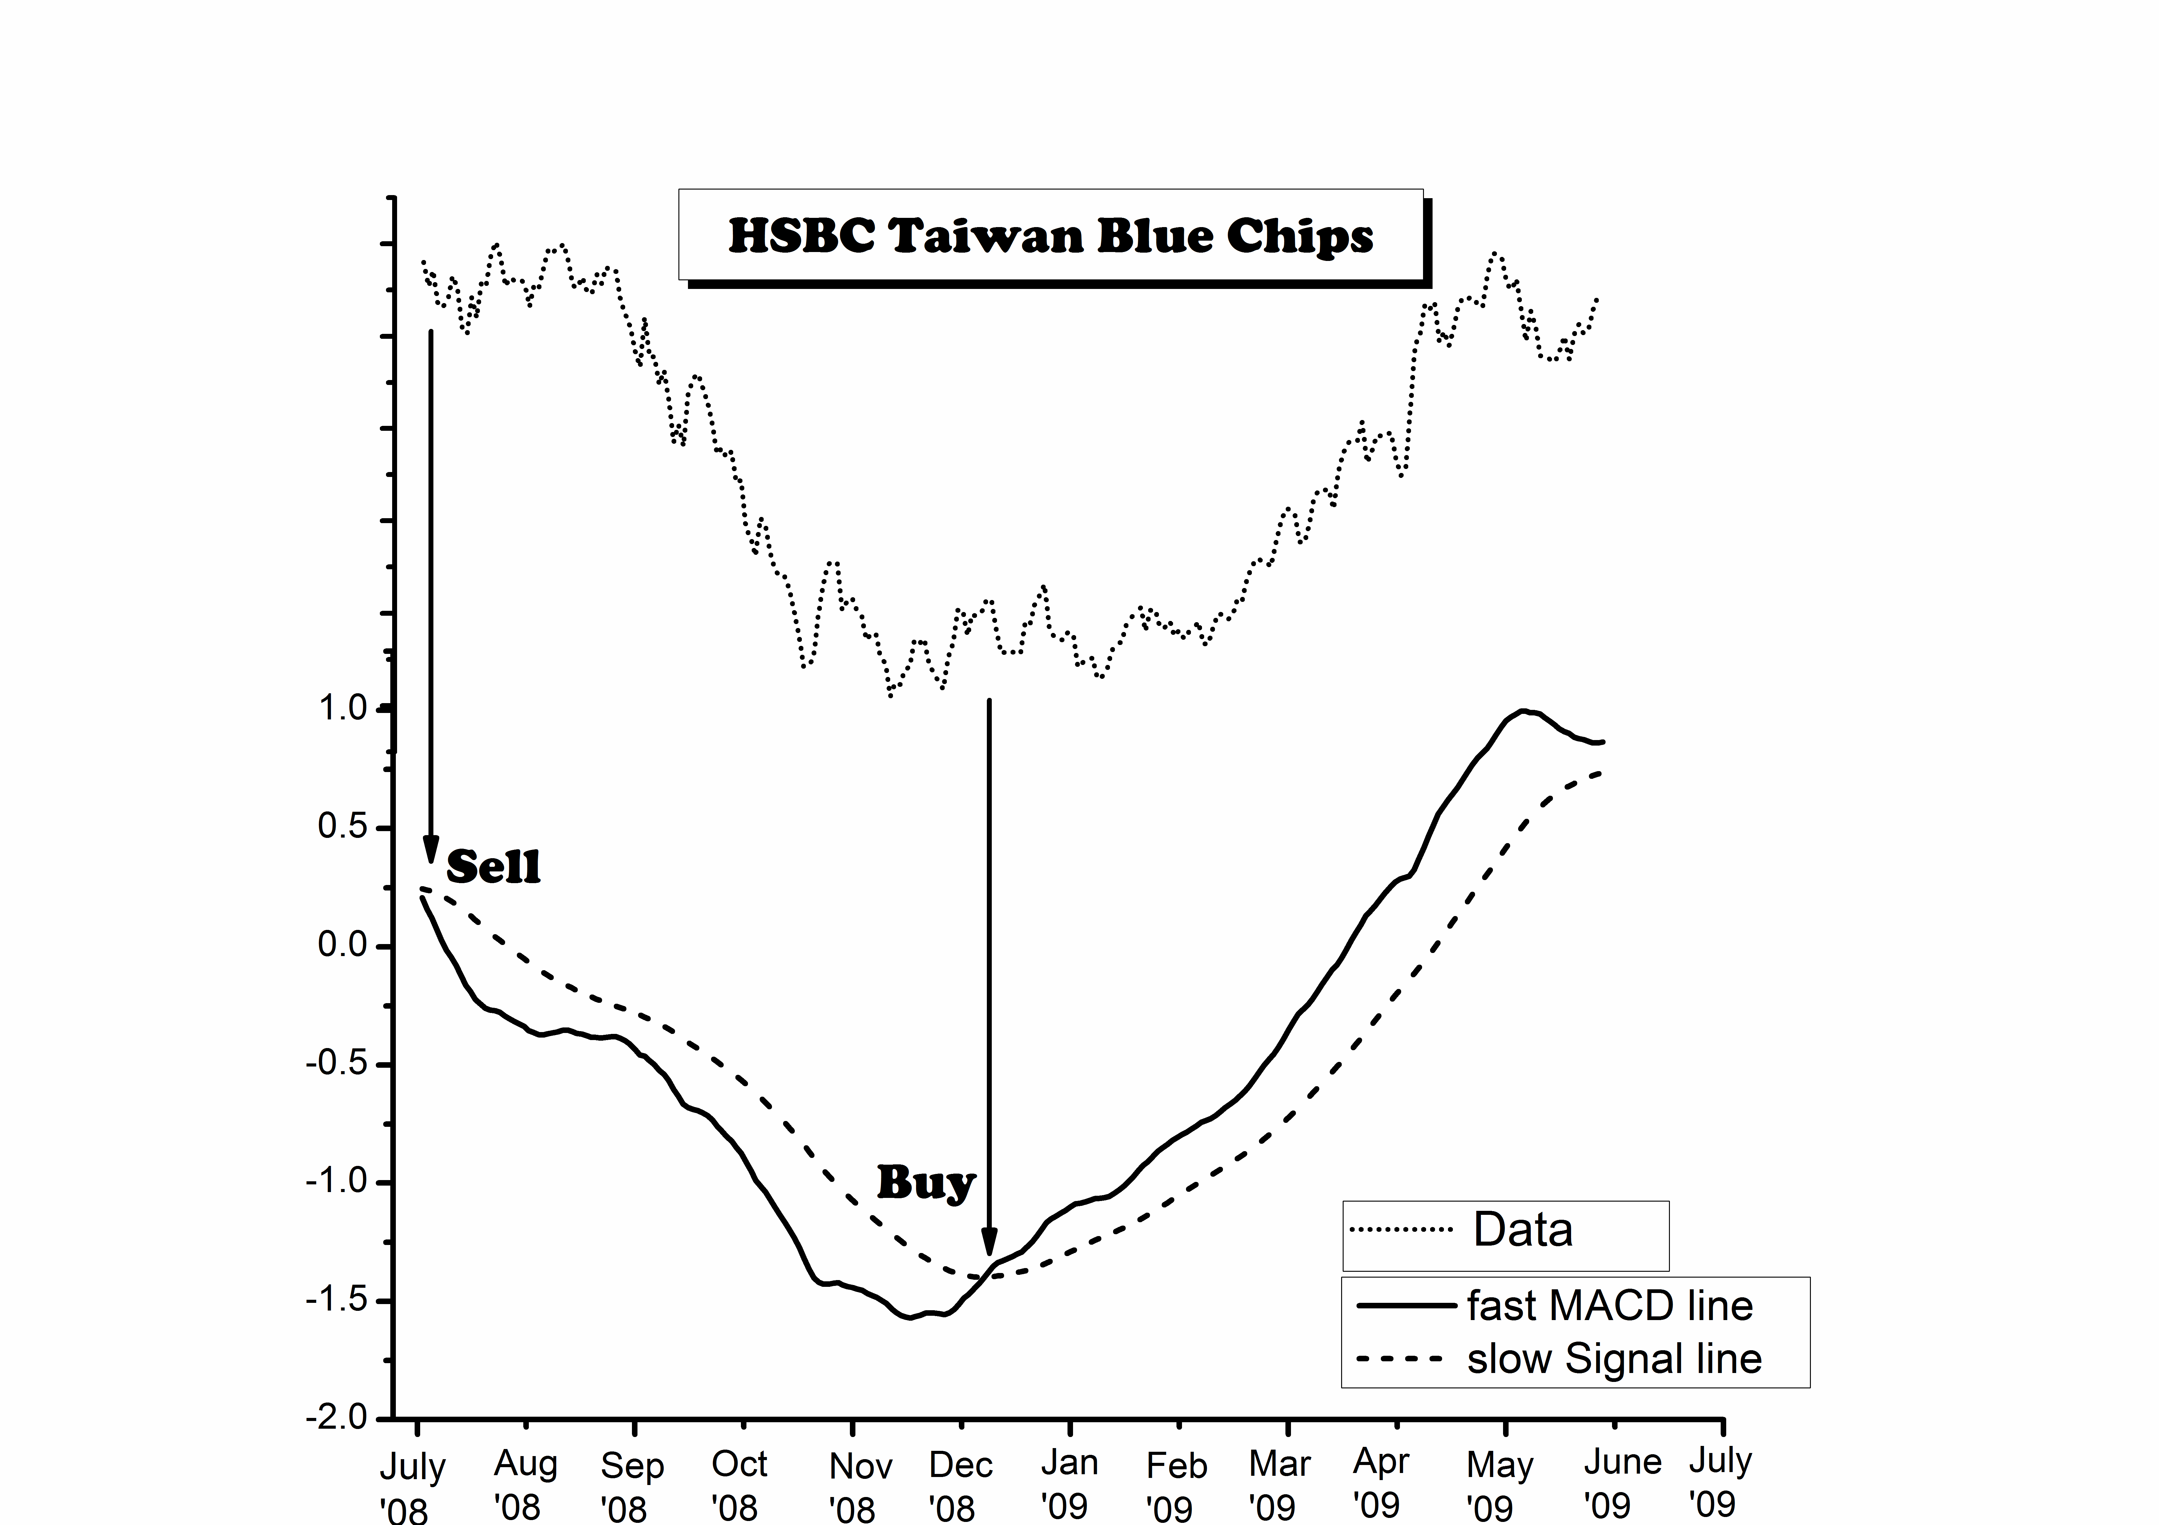
stock market analysis

Slide 9
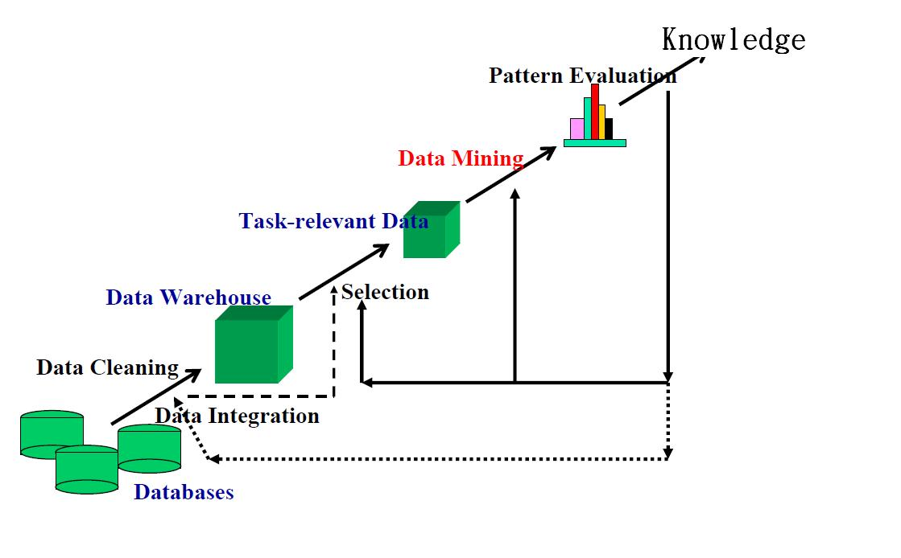
Process(I)

Slide 10
Process(II)
Data cleaning
  To remove noise and inconsistent data
  Data integration
  Multiple data sources may be combined
  Data selection
  Data relevant to the analysis task are retrieved from the database
  Data transformation
  Data are transformed or consolidated into forms appropriate for mining by performing summary or aggregation operations, for instance

Slide 11
Process(III)
  Data mining
  An essential process where intelligent methods are applied in order to extract data patterns
  Pattern evaluation
  To identify the truly interesting patterns representing knowledge based on some interestingness measures
  Knowledge presentation
  Visualization and knowledge representation techniques are used to present the mined knowledge to the user

Slide 12
Data Mining Can Use On What Kinds of Data
Database-oriented data sets and applications
  Relational database, data warehouse, transactional database
  Advanced data sets and advanced applications
  Data streams and sensor data
  Time-series data, temporal data, sequence data
  Structure data, graphs, social networks and multi-linked data
  Object-relational databases
  Heterogeneous databases and legacy databases
  Multimedia database
  Text databases
  The World-Wide Web

Slide 13
Kinds of Functionalities(I)
Concept Description
  Generalize, summarize, and contrast data characteristics
Association Analysis
  Discuss the relationship of the data
Classification and Prediction
  Construct models (functions) that describe and distinguish classes or concepts for future prediction
  Predict some unknown or missing numerical values

Slide 14
Kinds of Functionalities(II)
Cluster Analysis
  Group the similar data to form a new class, and describe the class
Outlier Analysis
  Outlier: Data object that does not comply with the general behavior of the data
  Useful in fraud detection, rare events analysis
Trend and Evolution Analysis
  regression analysis
  Sequential pattern analysis
  Periodicity analysis

Slide 15
Classification
The most important one of the functions is “classification”
EX：
Decision Tree Induction
NaïveBayes Classification
SVM，Support Vector Machine
Neural Network, Deep Learning, etc.

Slide 16
Classification-
Decision Tree Induction(I)
決策樹最主要由三個重要的元素所組成：節點（decision node）、分支（branch）、葉節點（leaf）。每個節點表示在某一個屬性上的測試，每個葉節點則表示一個測試結果，即想要分類的類別（class），而分支則代表每個屬性的可能值的範圍。

Slide 17
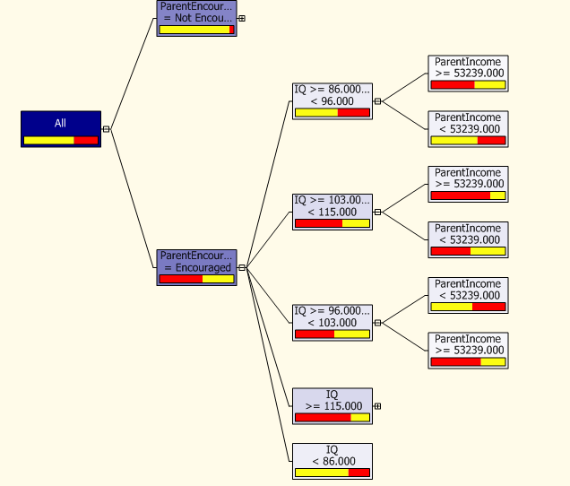
Classification-
Decision Tree Induction(II)
在給定一組訓練資料，它會選擇最適當的屬性值並將每筆訓練資料於葉節點中被分類，為了要產生決策樹必須先選擇最適合的根節點，重複計算依序由上而下產生其他的節點，最後在葉節點中被正確的分類。
在後面的章節將會
有更詳細之說明

Slide 18
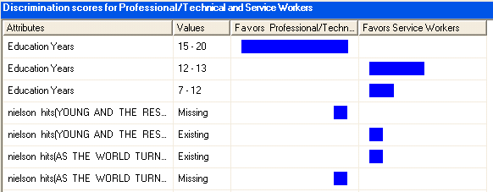
Classification-
NaïveBayes Classification
Naïve Bayes 分類法是根據統計學上的貝氏定理（Bayes Theorem）衍生而來的，在分類的領域上常常被用來與其他演算法做比較。
後面章節將有更
詳細之介紹

Slide 19
Classification-
Support Vector Machine(I)
SVM（Support Vector Machine）是Vapnik 為了解決在類神經網路上不可避免的問題所提出的方法，它是一種建立在統計學習理論基礎之上的機器學習方法，其最大的特點是根據結構風險最小化原則，儘量提高學習機的泛化能力，即由有限的訓練集樣本得到最小的誤差仍然能夠保證對獨立的測試集保持最小的誤差，SVM 根據有限的樣本資訊在模型的複雜性和學習能力之間尋求最佳折衷，以期獲得最好的推廣能力。

Slide 20
Classification-
Support Vector Machine(II)
它藉由一些support vectors 將資料分類， 而這些特徵空間（support vectors）是一些訓練資料的輸入值並可以在特徵空間中變成一個高平面（hyper plane）。而SVM 在很多方面的應用已經有不錯的分類效果，尤其是它可以將非線性問題轉化成線性問題，解決非線性分類的問題。
後面章節將有更詳細之說明

Slide 21
Patterns Interesting(I)
Data mining may generate thousands of patterns: Not all of them are interesting
EX:
Interestingness measures
  A pattern is interesting if it is easily understood by humans, valid on new or test data with some degree of certainty, potentially useful, novel, or validates some hypothesis that a user seeks to confirm

Slide 22
Patterns Interesting(II)
Objective vs. subjective interestingness measures
  Objective: based on statistics and structures of patterns
  Subjective: based on user’s belief in the data

Slide 23
Patterns Interesting(III)
Find all the interesting patterns: Completeness
  Can a data mining system find all the interesting patterns? Do we need to find all of the interesting patterns?
Search for only interesting patterns: An optimization problem
  Can a data mining system find only the interesting patterns?
  Approaches
    First general all the patterns and then filter out the uninteresting ones
    Generate only the interesting patterns—mining query optimization

Slide 24
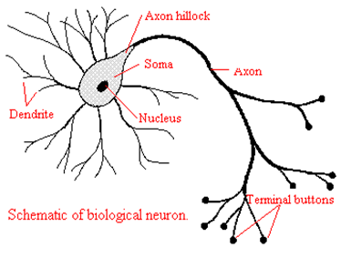
Other algorithm
There are a lot of algorithms in data mining
  Neural Network,etc.
We will introduction in other chapter

